Slide 1

Introduction
Md. Kamrul Islam
Lecturer, Dept. of CSE, RMU

Slide 2
How comes OOP?
Programming Language
Procedural Oriented Programming Language
Object Oriented Programming Language

Slide 3
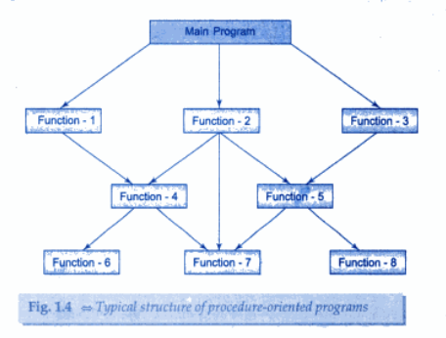
Procedure Oriented Programming
Emphasis in on doing things (algorithms)
Large programs are divided into smaller programs known as function.
Most of the functions share global data.
Data move openly around the system from function to function.
Function transform data from one form to another.

Slide 4
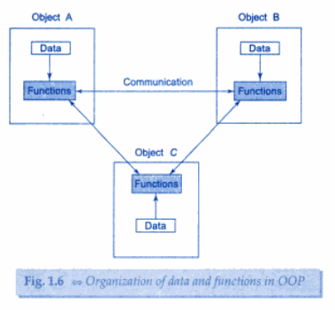
OOP
Emphasis is on data rather than procedure
Programs are divided into what are known as objects.
Data structures are designed such that they characterize the objects.
Function that operate on the data of an object are tied together in the data structure.
Data is hidden and cannot be accessed by external functions.
Objects may communicate with each other through functions.
New data and functions can be easily added whenever necessary.

Slide 5
POP vs OOP
Emphasis is on data rather than procedure
Programs are divided into what are known as objects.
Data structures are designed such that they characterize the objects.
Function that operate on the data of an object are tied together in the data structure.
Data is hidden and cannot be accessed by external functions.
Objects may communicate with each other through functions.
New data and functions can be easily added whenever necessary.
Follows bottom-up approach in program design.
Emphasis in on doing things (algorithms)
Large programs are divided into smaller programs known as function.
Most of the functions share global data.
Data move openly around the system from function to function.
Function transform data from one form to another.
Employs top-down approach in program design.

Slide 6
OOP
Object oriented programming encourages programmers to decompose a problem into its constituent parts.
Abstraction
Message Passing
Dynamic Binding
Static Binding
OOP
Encapsulation
Inheritance
Class and Object
Polymorphism

Slide 7

OOP: Encapsulation
Definition
Encapsulation is the mechanism that binds together code and the data it manipulates, and keeps both safe from outside interference and misuse.
In object oriented language, code and data can be combined in such way that a self-contained “black box” is created.
Private
Public

Slide 8
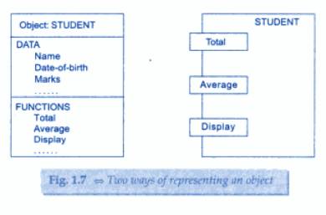
OOP: Object
Definition
Objects are basic run time entities in an object oriented system. They may represent a person, a place, a bank account, a table of data or any item that the program has to handle.

Slide 9
OOP: Class
Definition
A class is used to specify the form of an object and it combines data representation and methods for manipulating that data into one neat package.
In fact, objects are variables of the type class.
Fruit mango;

Slide 10
OOP: Inheritance
Definition
Inheritance is the process by which one object can acquire the properties of another.
Hierarchical classification
Without the use of ordered classifications, each object has to define all characteristics related to it explicitly.

Slide 11
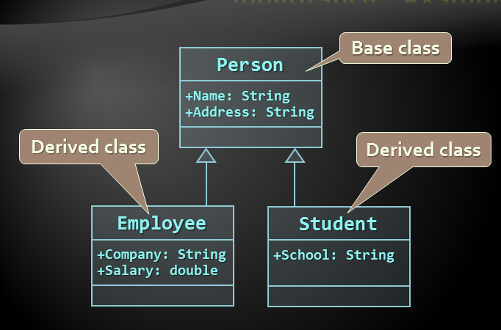
OOP: Inheritance

Slide 12
OOP: Polymorphism
Definition
Polymorphism is the quality that allows one name to be used for two or more related but technically different purposes.
polymorphism many forms
One interface, multiple methods
Function overloading
Operator overloading

Slide 13
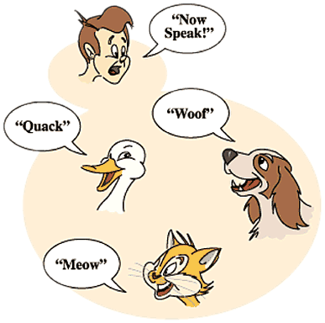
OOP: Polymorphism

Slide 14
C++?
In General we can say that C++ is the super class of C
Supports object oriented programming concept
C++
C

Slide 15
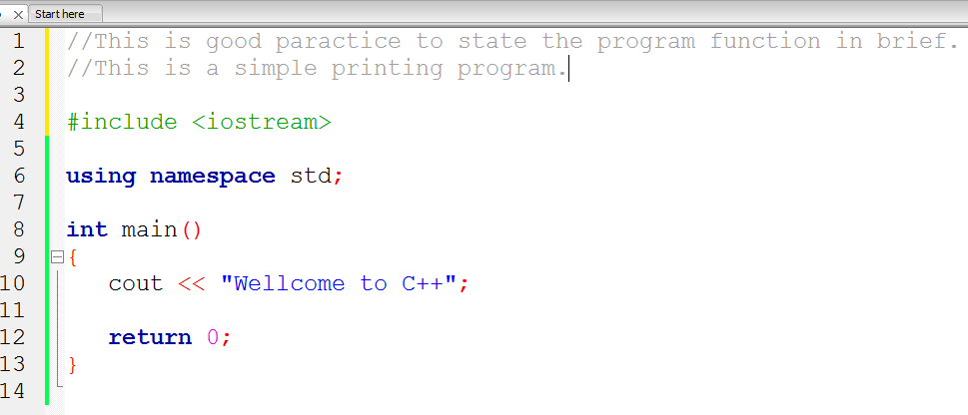
Basic Structure of C++ Program

Slide 16
#include <iostream>
a preprocessor directive
Lines that begin with # are processed by the preprocessor before the program is compiled.
include in the program the contents of the input/output stream header <iostream>.
We also can use C header files!!

Slide 17
#include <iostream>
We also can use C header files!!
<math.h>
<string.h>
<cmath>
<cstring>

Slide 18
using namespace std;
The namespace is simply a declarative region.
The namespace defines scope of an identifier.
Purpose is to localize the names of identifiers to avoid name collisions.
std is the namespace where C++ standard class libraries are defined.

Slide 19
cout <<
cout represents the standard output stream in C++
The << operator is referred to as the stream insertion operator.
When this program executes, the value to the operator’s right, the right operand, is inserted in the output stream.

Slide 20
return 0;
Use to EXIT function
Returns a value 0 to the calling procedure

Slide 21
C++ Console I/O
In C++ I/O is performed using I/O operators instead of I/O functions.
Output Operator is <<
cout<<expression;
Input Operator is >>
Cin>>variable;

Slide 22
Example:1
#include<iostream>
using namespace std;
int main(){
int a,b;
a=10;
b=20;
cout<<“Value of a and b”;
cout<< a;
cout<<‘ ‘;
cout<<b;
return 0;
}

Slide 23
Example:2
#include<iostream>
using namespace std;
int main(){
int a,b;
cout<<“Enter value of a and b”;
cin>>a>>b;
cout<< a<<endl;
cout<<b;
return 0;
}

Slide 24
Comments in C++
Program comments are explanatory statements that you can include in the C++ code that you write and helps anyone reading it's source code.
C++ supports single-line and multi-line comments
Single Line Comment can be written using //
Multi-line comments are written using /*……….*/

